Slide 1
Motion Graphic Guidelines
January 2025

Slide 2
Introduction
Motion graphics play an important role in enhancing recognition, storytelling, and engagement for our brand. It brings elements like our logo, graphic device, messaging and imagery to life, by establishing visual consistency through animation across our design assets.
Our approach to motion is guided by principles that we will detail in this document and strives to achieve coherence through a clear, concise and consistent motion language.
This guideline should help achieve the essence and cadence of how information is revealed in a purposeful and approachable way. While it provides stylistic guidance on how our assets animate or transition, it does not outline guidance on more complex applications like video or animation. The assets that are detailed in this document are intro/outros, typography, transitions and lower thirds.

Slide 3
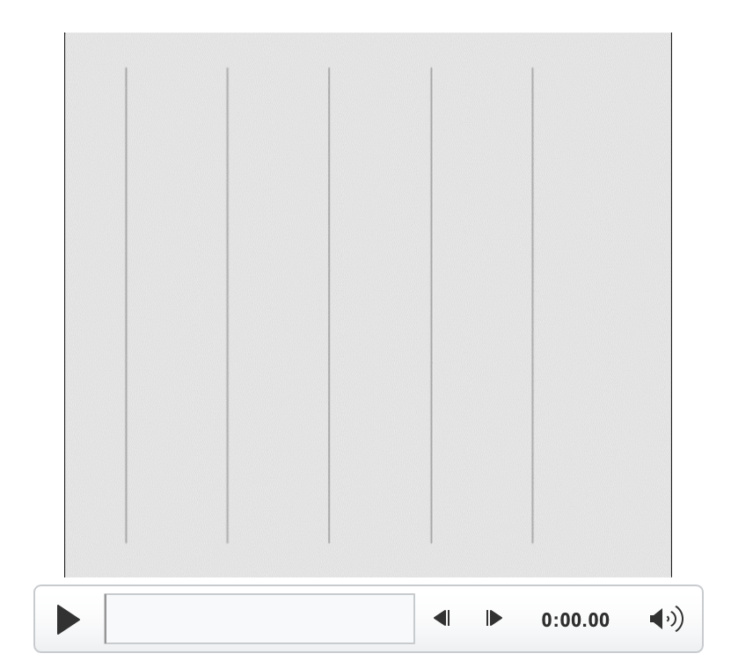

Viewing the animation
Our animation can be viewed two ways, in Presentation mode, where the animation will play automatically when you advance or in Normal mode.
Normal mode
Test it here
1. Hover over box or frame to reveal the play button
2. Click on arrow to play animation

Slide 4


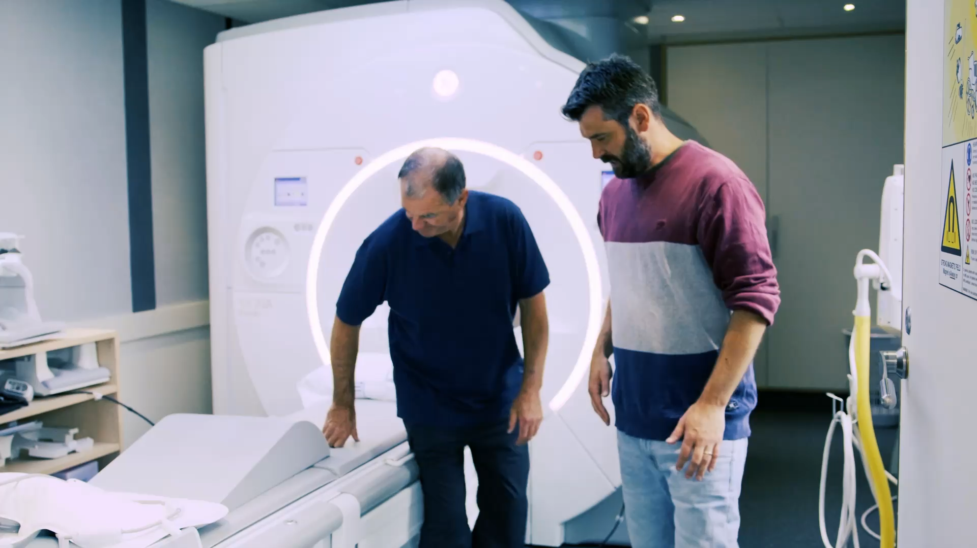

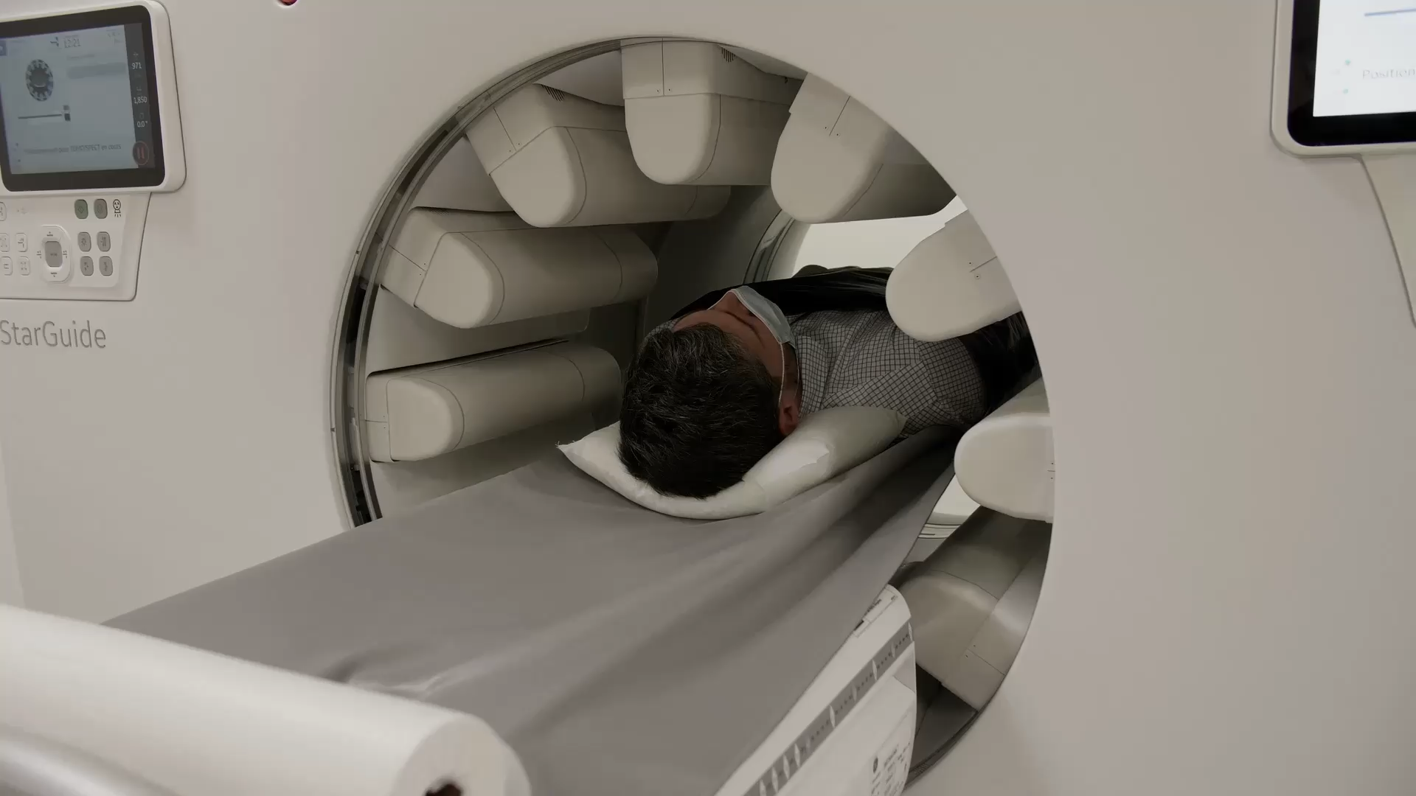

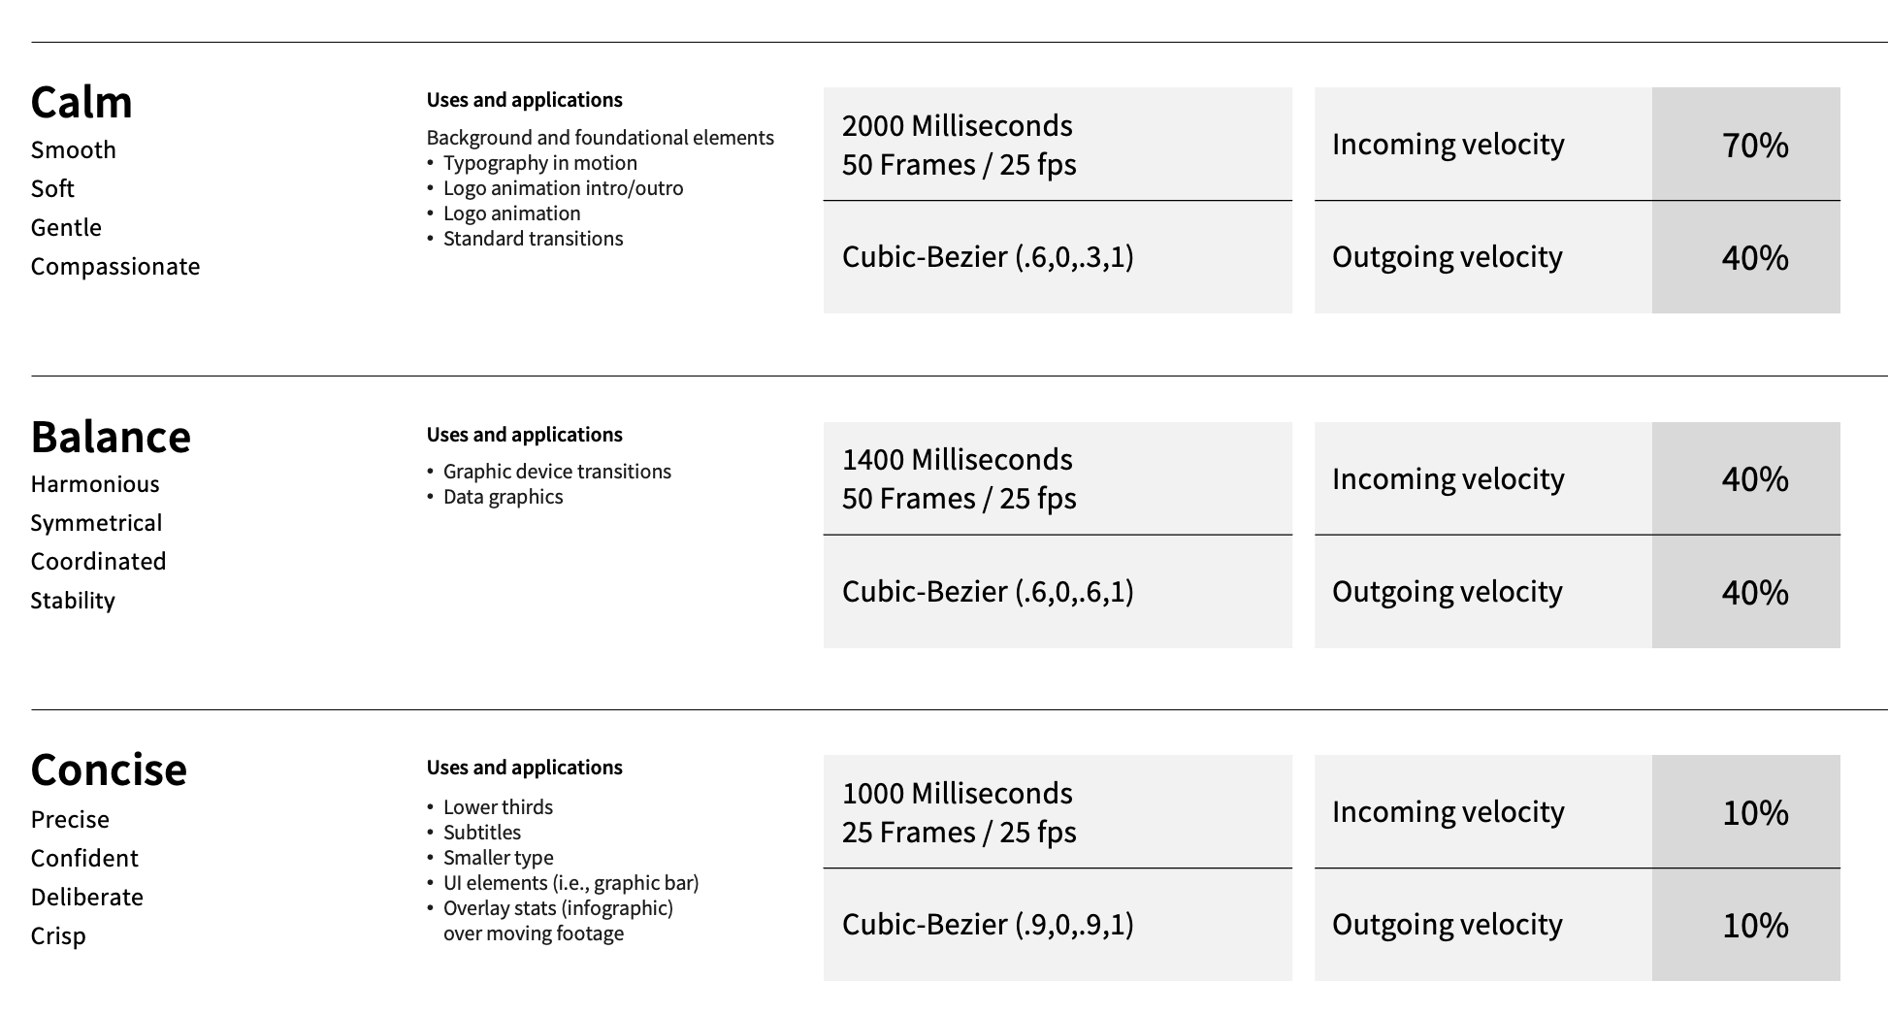
Table of contents
This document provides guidance on how logos, messaging and transitions of static or moving images come to life through animation.
Our approach to motion - page 5
Logo animation - page 6
Logo animation intro/outro – page 7
Typography in motion – page 8
With footage content​
Without footage content
Transitions – page 9
Lower thirds – page 11
Assets and technical information – page 13
Standard​
With copy
With graphic device​
With logo
Without logo

Slide 5
Our approach to motion graphics
We have established three foundational principles
to assist teams in creating effective graphic animations that aligns with our sense of compassion and optimism while also emphasizing precision. Please refer to page 12 of this guideline for further technical animation reference.

Slide 6
Our principles of motion graphics
Calm
Balance
Concise
Calm refers to the smooth and gentle movement of assets. The calm motion principle is an important tool for creating a sense of compassion. This creates fluidity and a soft flow of motion for elements like messaging where you need to have a moment of focus or pause.
Balance refers to the smooth and even movement of elements to create a sense of harmony and symmetry. There is a coordinated flow between elements, like transitioning between messaging to a product feature.
Concise movements are made with precision and confidence, moving with the least amount of effort and time. It’s deliberate and direct with no unnecessary motion, putting emphasis on being functional like UI elements (i.e., lower thirds).

Slide 7

Logo animation intro/outro
Animate in (intro)
Animate out (outro)
This is a universal logo animation that can be included at the beginning or end to bookend content.
The logo is a primary asset and utilizes the calm principle. For more information on this, please refer to page 13 of this document.
For more information about when to add our trademark disclaimer and copyright, please refer to the ‘Legal requirement’ section of our Brand Guidelines: “© 2025 GE HealthCare. GE is a trademark of General Electric Company used under trademark license.”
Our Brand Guidelines can be downloaded from this article on The Beat, as well as our externally accessible Agency Brand Portal.

Slide 8
Logo animation intro/outro – with content
Intro
Outro
Intro animation starts off with Compassion Purple background and white logo. It gradually fades into a video leveraging the calm principle. As it is the initial element of a video, the intro establishes a tone of compassion and gentle motion. For more information on our motion principles, please refer to page 13 of this document.
Outro animation is similar to the intro animation, with motion in the reverse – and ends with
Compassion Purple background with white logo. As it is the final element of a video, the outro reinforces a tone of compassion and gentle motion.

Slide 9


Typography in motion
Font shifted, please use the Source Sans Pro Semibold
When animating paragraph form of text, we want to establish a sense of calm in the
speed in which it animates to ensure a comfortable reading pace and cadence
for our international colleagues and customers. The text is stationary, left-aligned,
and the opacity is animated in and out as a whole from the beginning to end.
If you combine a music sequence with an animation, ensure the music's timing accurately aligns with the animation’s rhythm either to emphasize specific moments or to enhance the narrative.
When animating headline text over footage or static imagery, ensure the text is the primary focus and the footage is not distracting to reinforce the sense of balance and a coordinated flow between elements.
For more information on our calm and balance motion principles, please refer to page 13 of
this document.

Slide 10


Standard transitions
Transitions are a post-production technique used in video editing or film to connect one shot or element to another.
Horizontal transition
Horizontal transition into products
Standard transitions can be used in a variety of scenarios – from bringing on a title board
to cutting between footage. The standard transitions rely on the balance principle and use Compassion Purple as a transition device.

Slide 11
Graphic device transitions
Graphic device revealing video
Graphic device with animated text over video
Graphic device transitions can be used to bring in a separate block of information, from a piece of footage to text. In line with the standard transitions, these also
rely on the balance principle.

Slide 12

Lower thirds
A lower third is a combination of text and graphical elements placed in the lower area of the screen to give the audience more information.
With logo
Without logo
Lower thirds are used to add information about the content of the video, such as a person who is speaking or a site location, etc.
Leverage the version with the GE HealthCare logo if the video is for external purposes or the person speaking is in the context of external companies. In line with the concise motion principle, the movement is deliberate and direct.

Slide 13
Technical motion reference for animators
The following pages are a reference for animators to implement technical motion and transitions for our brand assets based on the principles we’ve established.

Slide 14


Our principles of motion graphics
Please note the distance between each circle in the animations below detail
the nuance, pace, rhythm and style of motion for each of our principles.
Calm
Balance
Concise
Calm refers to the smooth and gentle movement of assets. The calm motion principle is an important tool for creating a sense of compassion. This creates fluidity and a soft flow of motion for elements like messaging where you need to have a moment of focus or pause.
Balance refers to the smooth and even movement of elements to create a sense of harmony and symmetry. There is a coordinated flow between elements, like transitioning between messaging to a product feature.
Concise movements are made with precision and confidence, moving with the least amount of effort and time. It’s deliberate and direct with no unnecessary motion, putting emphasis on being functional like UI elements (i.e., lower thirds).

Slide 15
Calm
Calm refers to the smooth and gentle movement of assets. Calm motion is an important tool for creating a sense of compassion. This principle creates fluidity and soft flow of motion for elements like messaging where you need to have a moment of focus or pause.
2000 Milliseconds 50 Frames / 25 fps
Cubic-Bezier (.6,0,.3,1)
Incoming velocity | 70%
Outgoing velocity | 40%
Uses and applications
(Background and foundational elements)
Logo animation intro/outro
Logo animation
Standard transitions
Example of calm motion in action.

Slide 16

Balance
Balance refers to the smooth and even movement of elements to create a sense of harmony and symmetry. There is a coordinated flow between elements, like transitioning between messaging to a product feature.
1400 Milliseconds 50 Frames / 25 fps
Cubic-Bezier (.6,0,.6,1)
Incoming velocity | 40%
Outgoing velocity | 40%
Uses and applications
Standard transitions
Graphic device transitions
Data graphics
Example of balanced motion in action.

Slide 17


Concise
Concise movements are made with precision and confidence. It is deliberate and direct with no unnecessary motion, putting emphasis on being functional like UI elements (i.e., lower thirds). Elements move with the least amount of effort and time.
1000 Milliseconds 25 Frames / 25 fps
Cubic-Bezier (.0,0,.9,1)
Incoming velocity | 10%
Outgoing velocity | 10%
Uses and applications
Lower thirds
Subtitles
Smaller type
UI elements (i.e., graphic bar)
Overlay stats (infographic) over moving footage
Example of concise motion in action.

Slide 18
Technical motion reference for animators
Calm
Uses and applications
2000 Milliseconds 50 Frames / 25 fps
Cubic-Bezier (.6,0,.3,1)
Incoming velocity | 70%
Outgoing velocity | 40%
Smooth
Soft
Gentle
Compassionate
Background and foundational elements
Logo animation intro/outro
Logo animation
Typography in motion
Balance
Uses and applications
1400 Milliseconds 50 Frames / 25 fps
Cubic-Bezier (.6,0,.6,1)
Incoming velocity | 40%
Outgoing velocity | 40%
Harmonious
Symmetrical
Coordinated
Stability
Standard transitions
Graphic device transitions
Data graphics
Concise
Uses and applications
1000 Milliseconds 25 Frames / 25 fps
Cubic-Bezier (.9,0,.9,1)
Incoming velocity | 10%
Outgoing velocity | 10%
Precise
Confident
Deliberate
Crisp
Lower thirds
Subtitles
Smaller type
UI elements (i.e., graphic bar)
Overlay stats (infographic) over moving footage

Slide 19
General brand questions
The Brand team
brand.health@gehealthcare.com
For feedback on this guideline,
please add your comments to
this short survey.
Brand guidelines & templates
Brand page on The Beat
(GE HealthCare colleagues)
Externally accessible
Agency Brand Portal
(Contractors & agencies)
Widen image DAM
(To gain external access to our
image library, please contact
brand.health@gehealthcare.com)
For more information on our available guidelines and training, please refer to this article on The Beat.
For more information on our branded templates,
refer to the Brand page of The Beat.

