Slide 1
Ethos Design System (EDS) icons for PowerPoint
Updated March 2026

Slide 2
Considerations
Things to consider before using these icons
All icons in this PPT are meant to be used in PowerPoint. In case you need vector version please download them from our box folder.
Be aware to not change the icon proportions when you export it into your own presentation.
Be mindful to use the light or dark versions of the icons according to the background they will be placed on and remember you can use these icons in any GE HealthCare palette color.
All icons are organized alphabetically, you can go into “Find” in the Home tab and type the name of the icon you’re looking for to make your search easier.
In case the word you typed in your search doesn’t exist in this file, we suggest you try to search by keywords through this website.
For more information on iconography, please refer to this article on The Beat

Slide 3
Icon change log
Date: 27 March 2025
New icons
AI Reset
Baseline
Refresh Prompt
Report – Alert
Sheet View 1x1 Stacked
Sheet View 1x1+3x1
Status Unknown
Urethral Catheter

Slide 4
Welcome

Slide 5


Ethos Design System (EDS)
Why use EDS?
EDS is an internally built and supported design system library that ensures a consistent look and feel across GE HealthCare digital applications, products, and marketing collateral.
It provides a robust icon library, with icons specifically designed for GE HealthCare products and applications, all aligned with the EDS Icon Style Guide.
This consistency in icon sets delivers a dependable design language that healthcare workers recognize, optimizing operational efficiency.

Slide 6
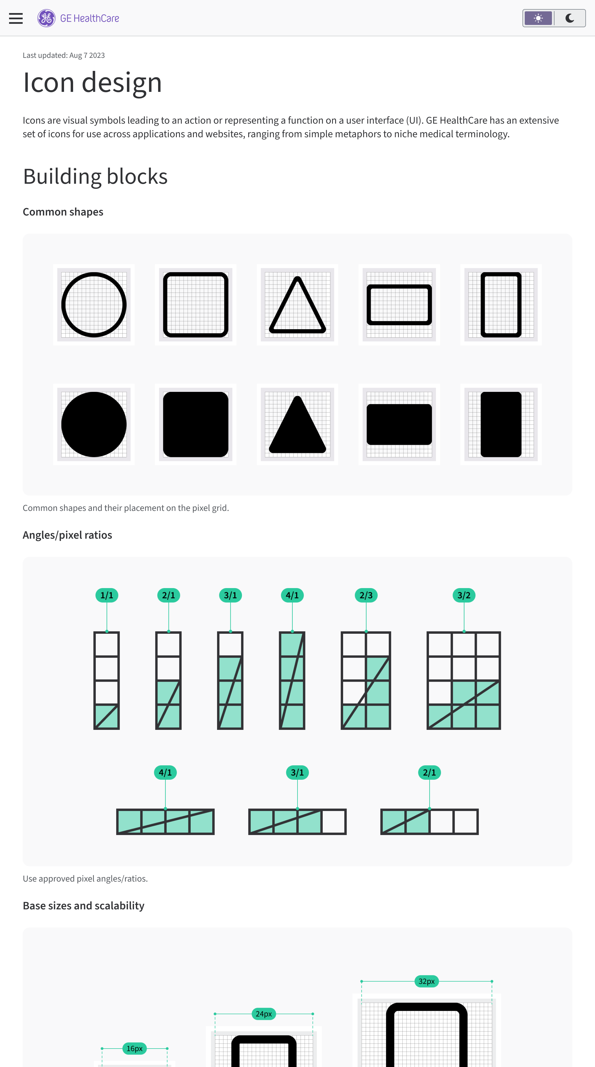
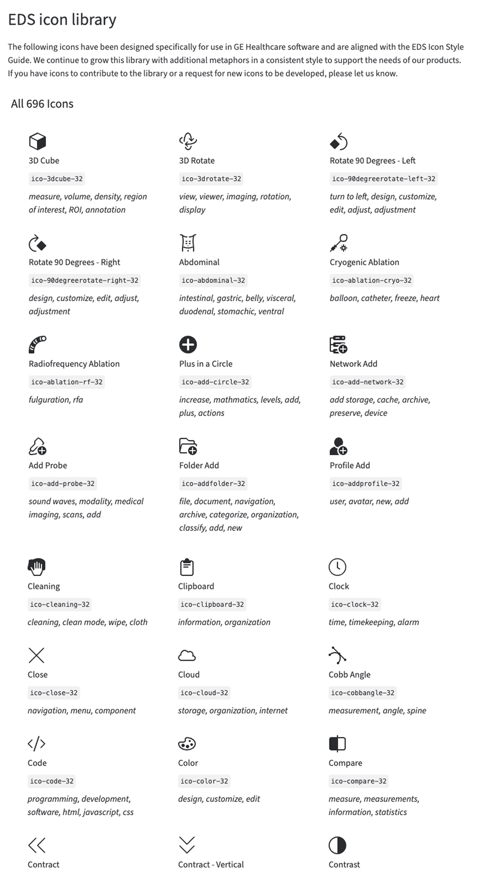


Icon style guide
GE HealthCare’s iconography style guide
This document serves to help marketers and designers create common and consistent icons leveraging the Ethos Design System (EDS) iconography style guide.
GE HealthCare has an extensive set of icons for use across applications and websites, ranging from simple metaphors to niche medical terminology.

Slide 7
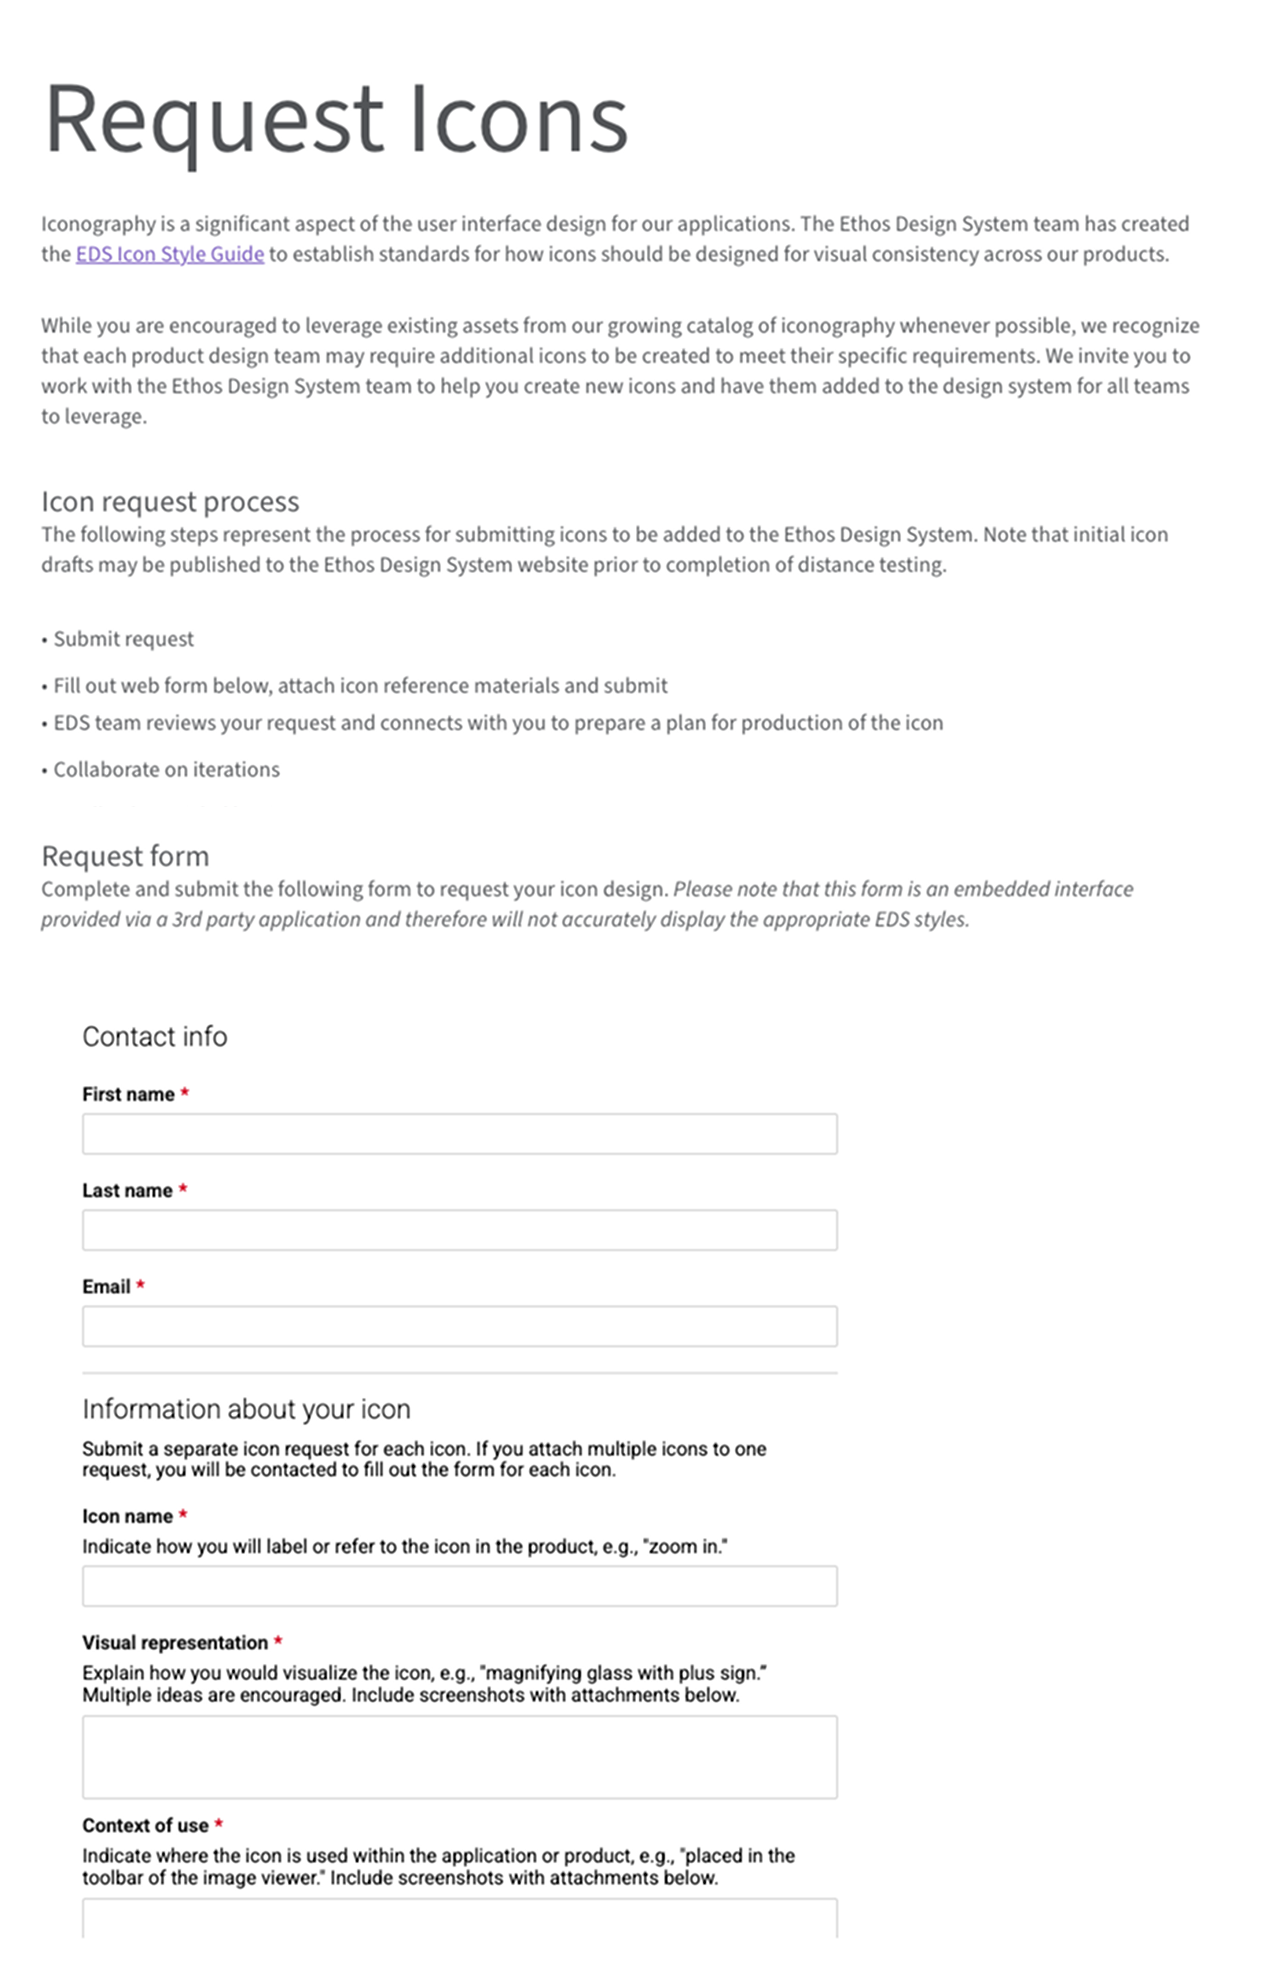

The icon library
Usage
The icons on the following pages range from universal symbols to niche medical and imaging terminology and can be used across marketing communications and digital experiences.
Tested and certified
All icons have been tested with validated visual symbolism.
Icon requests
We continue to grow this library with a consistent style to support the needs of our products. If you have icons to contribute to the library or requests for new icons to be developed, please let us know.

Slide 8
EDS Icons - Light
Icons to be used over a light background

Slide 9
3D Cube
3D Rotate
30 Day Readmit

Slide 10
Abdominal
Add Probe
Advance Search
AI
AI Chat
AI Image
AI Layout
AI Measurement
AI Report
Alert
Align Bottom
Align Horizontal Center
Align Left
Align Right
Align Top
Align Vertical Center
Annotate Freehand
Annotation

Slide 11
Apple
Application Execution
Application Profile
Applist
Archive
Area Zoom
Arrow Annotation 1
Arrow Annotation 2
Arrow Annotation 3
Arrow Annotation 4
Arrow Down
Arrow Left
Arrow Right
Arrow Up
Attach
Auto Save
Avatar
Avatar Locked

Slide 12
Affirm
Amex
Alert Status High
Alert Status Low
Alert Status Medium
Auto Voice
Auto Voice Off
Award
Ambulance
Axillary
Advance To Scan - Simplified
Add Annotation
Auto-Fill
AI Genie
AI Prompt
AI Reset

Slide 13
Back to 2D
Back to 3D
Back View
Back View Off
Ban
Bar Chart
Barcode
Battery 25%
Battery 50%
Battery 75%
Battery Charging
Battery Error
Battery Full
Battery Low
Battery None
Battery Settings
Bladder
Blood Pressure

Slide 14
Bluetooth
Bookmark
Bookmark Outline
Brain Sagittal
Brightness
Brightness 0%-25%
Brightness 26%-50%
Brightness 51%-75%
Brightness Reset
Bring To Front
Brush
Bug
Building
Blood pressure cuff – auto start
Blood pressure cuff – auto stop
Blood pressure cuff – start
Blood pressure cuff – stop
Batch Parallel

Slide 15
Batch Radial
Batch Rotation
Bore Tilt
Brush – Add Mode
Brush – Remove Mode
Battery Charging - 25%
Battery Charging - 50%
Battery Charging - 75%
Battery Charging - Full
Battery Charging - Low
Begin Ultrasound Exam
Barcode Scanner
Brush 2-Color
Baseline

Slide 16
Calendar
Call
Camera
Caps Lock - Off
Caps Lock - On
Cardio
Caret Down
Caret Left
Caret Right
Caret Up
CD Drive
Certificate
Change Case
Charging
Chat
Checkbox Component
Checklist
Checkmark

Slide 17
Checkmark in Circle
Chest
Cine
Cine Align
Cine Failure
Cine Free
Cine Start
Circle
Cleaning
Clipboard
Clock
Close
Cloud
Cobb Angle
Code
Color
Compare
Contract

Slide 18
Contract - Vertical
Contrast
Contrast Reset
Copy
Credit Card
Crop
Cross Reference
Cryogenic Ablation
CT
CT-PET
CTR Measure
Cursor Select
Curved Distance
Cut
Contrast Aware Brush
Classroom
Checkmark in Circle - Success
Cradle Home - Simplified

Slide 19
Confirm Landmark - Simplified
Calendar Last 30-Days
Calendar Last 90-Days
Change Priority
Closed Captions
Cloud Settings
Combine
Continuity of Care
Cursor Select 2 Color
Close Parenthesis

Slide 20
Dashboard
Database
Database Export
Database Remove
Database Search
Database Validated
Debug
Delete
Delete All Annotations
Delete All Sheets
Delete Sheet
Delete Single Annotation
Detach
Diet
Difference
Digestive
Disk Space - 25%
Disk Space - 50%

Slide 21
Disk Space - 75%
Disk Space - Empty
Disk Space - Full
Distance
Doctor
Document
Document - Add
Document - Export
Document CSV
Document Excel
Document PDF
Document PowerPoint
Document RAW
Document Text
Document VAL
Document Word
Down
Down To Last

Slide 22
Download
Download Unavailable
Discover
Database Settings
Different Timezone
Document Import
Date Time
Divider
Doctor Unknown
Document-Validated
Division

Slide 23
Ear
Eco Mode
Edge Device
Edit
Edit Form
Edit List
Edit Unavailable
Eject
Electrical Cardioversion
Ellipse
Elliptical Region
Emergency
End Call
Endocrine System
Erase
Error
Ethernet
Ethernet Disconnected

Slide 24
Exam
Exchange
Exercise
Exit Full Screen
Expand
Expand - Vertical
Export
ECG
ECG Test History List
Error High
Error Warning
Exclude
Export - JPG
Export - MP4
End Ultrasound Exam
Environmental

Slide 25
Facebook
Factory
Factory Restore
Fan
Fast Forward
File Unsupported
Filter
Fit - Horizontally
Fit - Match Resolution
Fit - Vertically
Flag
Flag Outline
Flip Horizontal
Flip Vertical
Folder
Folder Add
Folder Select Up
Folder Settings

Slide 26
Font Size
Foot
Form Error
Forward Email
Free Rotate
Freehand with Anchor Points
Freeze
Freeze Pane
Full Screen
Female
Fetal
Fixed Width Spacer
Fall Risk

Slide 27
GE HealthCare
GE HealthCare Stacked
Generic List
Genetics
Global Stack
Google Play
Grid Settings
Grid View
Group
Group Objects
Github
Group by Patient
Gender - Unknown

Slide 28
Hamburger Menu
Hand Gesture
Hand - Grasp
Hanging Protocol
Hard Drive
Head
Healthcare
Heart - Filled
Heart - Outline
Heart Coincidence
Height
Help
Hide Location
Hide Panel
Hide Preview
History
Home
Hospital

Slide 29
Headset
Horizontal Stack Bar Chart
Housing Unknown
Hide Presentation State

Slide 30
ID Credentials
Image
Image Search
Images Zero
Import
Indent Left
Indent Right
Info
Injection
Instagram
Intravenous
Invert
Inverventional
Invoice
Intersect

Slide 31
Key
Keyboard
Keyboard- hide
Kidneys
Key - Unavailable
KPI

Slide 32
Lab
Lan Active
Lan Connected
Lan Disconnected
Landmark
Language
Laptop
Layout 1+2
Layout 1+2x2
Layout 1+3
Layout 1x1
Layout 1x2
Layout 1x3
Layout 1x4
Layout 2+1
Layout 2+3
Layout 2x1
Layout 2x2

Slide 33
Layout 2x3
Layout 2x4
Layout 3+1
Layout 3+2
Layout 3x1
Layout 3x2
Layout 3x3
Layout 4x1
Layout 4x2
Layout 4x4
Light Test
Lightbulb
Lightbulb Off
Line Down
Line Graph
Line Up
Link
Liver Autocontour

Slide 34
Location
Lock
Log In
Log Out
Loop
Lower Extremities
Lungs Expanding
Landscape
LinkedIn
Layout MPR + 1
Lesion
Line Graph Hide
Load Patient
Layout 1+2+1
Layout 1+2+2
Layout 1+2x1
Layout 1+3x1
Layout 2+1+1

Slide 35
Layout 2+1+2
Layout 2+1x2
Layout 2+2+1
Layout 2x1+1
Layout 2x1+3x1
Layout 3x1+1
Layout 3x1+2x1
Lollipop Chart
Landmark 2-Color
Line Spacing

Slide 36
Magic Wand 1
Magic Wand 2
Magic Wand 3
Magic Wand 4
Magic Wand 5
Magic Wand on Liver
Magnet
Mail
Mammography
Manual
Measurement - Angle
Measurement - Circle
Measurement - Cube
Measurement - Polygon
Measurement - Sphere
Measurement - Square
Measurement Ratio
Measurements

Slide 37
Medical Device
Medication
Merge
Message
Microphone
Microphone - Mute
Minus
Minus / Minus
Minus / Plus
Minus Heavy
Mobile Device
Module
Modules
Money
Monitor
Moon
More
More - Vertical

Slide 38
Move
Move Panel - Horizontal
Move Panel - Vertical
MR
MR-PET
MS Teams
Multi Oblique
Multi Select
Muscular
Musculoskeletal
Mastercard
Mouse
Media Skip Fast Backward
Media Skip Fast Forward
Media Skip Slow Backward
Media Skip Slow Forward
Magic Wand – Add Mode
Magic Wand – Remove Mode

Slide 39
Marker
Music Notes
Meds to Beds
Monitor Portrait
Monitor Wide
Music Off
Male
Magnifying Glass
Marker 2-Color
Move 2-Color

Slide 40
Neck
Nerves
Nervous System
Network
Network
Network
Network
Network
Network Add
Network Check
Network Connectivity
Network Printer
Network Settings
Next Frame
Notes
Notification
Notification - Off
Null

Slide 41
Numbered List

Slide 42
OBGYN
Offline
Oncology
Open Panel Bottom
Open Panel Left
Open Panel Right
Open Panel Top
Oral
Orbit
Overlay
Oxygenation
OpenID Connect
Open Parenthesis

Slide 43
Pacemaker
Pacemaker Unknown
Page Margin
Paging - Rotate
Pan
Pan Image
Paper Jam
Paragraph - Center Align
Paragraph - Justify
Paragraph - Left Align
Paragraph - Right Align
Paste
Patient
Patient Bed
Patient Bed Empty
Patient Checklist
Patient Connected
Pause

Slide 44
Pediatrics
Pelvis
Perinatal
PET
Pharmacological Cardioversion
Pharmacy
Pie Chart
Pin
Pin Outline
Placeholder
Play
Plus
Plus / Minus
Plus / Plus
Plus Heavy
Plus in a Circle
Point Angle 1
Point Angle 2

Slide 45
Point Angle 3
Point Angle 4
Point Down
Point Left
Point Right
Point Up
Polygon
Portrait
Power
Pregnancy
Prescription
Presentation State
Preview
Previous Frame
Print
Print - Freeze
Print In Progress
Print Settings

Slide 46
Printer Warning
Profile Add
Profile Remove
Prone
Proview
Push-to-Talk
Pathology
Priority- medium
PET Injections
Picture In Picture
Pop-in
Pop-out
Pinned Prompts

Slide 47
QR Code

Slide 48
Radiofrequency Ablation
Record
Rectal
Rectangle
Rectangular Shutter
Recycle Bin Settings
Redo
Refresh
Remote Screen Control
Remove
Remove Favorite
Reorder
Replace Label
Reply All Email
Reply Email
Report
Report Settings
Reproductive

Slide 49
Reset
Resize
Resize Horizontal
Resize Vertical
Respiratory
Return
Rewind
RFID
Rotate 90 Degrees - Left
Rotate 90 Degrees - Right
RSS
Ruler
Radiation therapy
React
Remove - Red
Replace
Return To Landmark - Simplified
Restart

Slide 50
Reopen Ultrasound Exam
Resume Ultrasound Exam
Report - Completed
Report - Delayed
Report - Error
Report - Unknown - Status
Resize Horizontal 2-Color
Resize Vertical 2-Color
Refresh Prompt
Report - Alert

Slide 51
Save
Save Layout
Save Settings
Save Validated
Scalpel
Scalpel on Liver
Scan
Scanning Protocol
Scatter Plot
Screen Share
Screenshot
Screw
Screw Label
Scroll
Search
Security
Segmentation
Send

Slide 52
Send Email
Send To Back
Send To Cloud
Series
Series Info
Series Selector
Service
Settings
Share
Shared Fleet
Sheet View 1x2
Sheet View 1x3
Sheet View 1x4
Sheet View 2x1
Sheet View 2x2
Sheet View 2x3
Sheet View 3x1
Sheet View 3x2

Slide 53
Sheet View 3x3
Sheet View 4x1
Shift
Shift Filled
Shopping Cart
Show Layout
Simple Oblique
Sitting
Skeletal
Smart Brush
Software Update
Sort
SPECT
Standing
Star - Filled
Star - Outline
Star Half
Stationary Console

Slide 54
Status - Available
Status - Away
Status - Busy
Status - Do Not Disturb
Status - Offline
Stop
Stop Blood Pressure
Stop Printing
Stop Screen Share
Stop Stopwatch
Streaming
Supine
Sync
Slices
Slices
Service Contract
Shipping Truck
Settings reset

Slide 55
Screenshot PNG
Screenshot SCPT
Split Graph
Split Horizontally
Split Vertically
Stop Cradle
SAML
Security Verified
Split
Subtract
Serial ECG
Surgical Imaging
Sheet View 1x1 Stacked
Sheet View 1x1+3x1
Status Unknown

Slide 56
Tablet
Tag
Text - Bold
Text - Italic
Text - Strikethrough
Text - Underline
Text Wrap
Thermometer
Threshold
Thumbs Down
Thumbs Up
Timeline
Toes
Tools
Trackpad
Trash
Tree Navigation
Trends

Slide 57
Tilt Left
Tilt Right
Table Horizontal Position
Table Speed
Table Vertical Position
Threshold Brush
Time Expired
Time In Progress
Trending Down
Transfer to Hospital
Transfer to Hospital - Unavailable
Telemetry
Thumbs Down- Filled
Thumbs Up - Filled
Table In
Table Out

Slide 58
Ultrasound
Undo
Unfreeze
Ungroup Objects
Universal Zoom
Unlink
Unlock
Unsent
Up
Up To First
Upload
Upper Extremities
USB
USB Connected
USB Not Connected
USB Save From
USB Save To
User

Slide 59
User in Brackets
User in Brackets - Off
User Settings
USB Disabled
Upload Patient
Ultrasound Exam
Ultrasound Exam – Review
Urethral Catheter

Slide 60
Vascular
Vector
Vector Shape
Vertebrae
Vertebrae Label
Video Camera
Video Camera - Filled
Video Camera - Filled - Off
Video Camera - Off
Viewport Add
Viewport Bottom Left
Viewport Bottom Right
Viewport Hide All
Viewport Hide Selected
Viewport Settings
Viewport Show All
Viewport Show Selected
Viewport Sync

Slide 61
Viewport Top Left
Viewport Top Right
Virtual Care
Vision
Volume - Low
Volume - Maximum
Volume - Medium
Volume - Mute
Visa
Variable Width Spacer

Slide 62
Ward
Weight
Width
Wifi
Wifi Low Signal
Wifi Medium Signal
Wifi No Signal
Win Together
Window Large
Window Medium Position Left
Window Medium Position Right
Window Minimized Position Bottom Left
Window Minimized Position Bottom Right
Window Minimized Position Top Left
Window Minimized Position Top Right
Window Small Position Bottom Left
Window Small Position Bottom Right
Window Small Position Top Left

Slide 63
Window Small Position Top Right
Wireless Charging
WL Presets
Women’s Health
Workflow
WW/WL
WW/WL Reset
Wheelchair Transport

Slide 64
X
Xray

Slide 65
YouTube

Slide 66
Zoom In
Zoom Out

Slide 67
EDS Icons - Dark
Icons to be used over a dark background

Slide 68
3D Cube
3D Rotate
30 Day Readmit

Slide 69
Abdominal
Add Probe
Advance Search
AI
AI Chat
AI Image
AI Layout
AI Measurement
AI Report
Alert
Align Bottom
Align Horizontal Center
Align Left
Align Right
Align Top
Align Vertical Center
Annotate Freehand
Annotation

Slide 70
Apple
Application Execution
Application Profile
Applist
Archive
Area Zoom
Arrow Annotation 1
Arrow Annotation 2
Arrow Annotation 3
Arrow Annotation 4
Arrow Down
Arrow Left
Arrow Right
Arrow Up
Attach
Auto Save
Avatar
Avatar Locked

Slide 71
Affirm
Amex
Alert Status High
Alert Status Low
Alert Status Medium
Auto Voice
Auto Voice Off
Award
Ambulance
Axillary
Advance To Scan - Simplified
Add Annotation
Auto-Fill
AI Genie
AI Prompt
AI Reset

Slide 72
Back to 2D
Back to 3D
Back View
Back View Off
Ban
Bar Chart
Barcode
Battery 25%
Battery 50%
Battery 75%
Battery Charging
Battery Error
Battery Full
Battery Low
Battery None
Battery Settings
Bladder
Blood Pressure

Slide 73
Bluetooth
Bookmark
Bookmark Outline
Brain Sagittal
Brightness
Brightness 0%-25%
Brightness 26%-50%
Brightness 51%-75%
Brightness Reset
Bring To Front
Brush
Bug
Building
Blood pressure cuff – auto start
Blood pressure cuff – auto stop
Blood pressure cuff – start
Blood pressure cuff – stop
Batch Parallel

Slide 74
Batch Radial
Batch Rotation
Bore Tilt
Brush – Add Mode
Brush – Remove Mode
Battery Charging - 25%
Battery Charging - 50%
Battery Charging - 75%
Battery Charging - Full
Battery Charging - Low
Begin Ultrasound Exam
Barcode Scanner
Brush 2-Color
Baseline

Slide 75
Calendar
Call
Camera
Caps Lock - Off
Caps Lock - On
Cardio
Caret Down
Caret Left
Caret Right
Caret Up
CD Drive
Certificate
Change Case
Charging
Chat
Checkbox Component
Checklist
Checkmark

Slide 76
Checkmark in Circle
Chest
Cine
Cine Align
Cine Failure
Cine Free
Cine Start
Circle
Cleaning
Clipboard
Clock
Close
Cloud
Cobb Angle
Code
Color
Compare
Contract

Slide 77
Contract - Vertical
Contrast
Contrast Reset
Copy
Credit Card
Crop
Cross Reference
Cryogenic Ablation
CT
CT-PET
CTR Measure
Cursor Select
Curved Distance
Cut
Contrast Aware Brush
Classroom
Checkmark in Circle - Success
Cradle Home - Simplified

Slide 78
Confirm Landmark - Simplified
Calendar Last 30-Days
Calendar Last 90-Days
Change Priority
Closed Captions
Cloud Settings
Combine
Continuity of Care
Cursor Select 2 Color
Close Parenthesis

Slide 79
Dashboard
Database
Database Export
Database Remove
Database Search
Database Validated
Debug
Delete
Delete All Annotations
Delete All Sheets
Delete Sheet
Delete Single Annotation
Detach
Diet
Difference
Digestive
Disk Space - 25%
Disk Space - 50%

Slide 80
Disk Space - 75%
Disk Space - Empty
Disk Space - Full
Distance
Doctor
Document
Document - Add
Document - Export
Document CSV
Document Excel
Document PDF
Document PowerPoint
Document RAW
Document Text
Document VAL
Document Word
Down
Down To Last

Slide 81
Download
Download unavailable
Discover
Database Settings
Different Timezone
Document Import
Date-Time
Divider
Doctor Unknown
Document-Validated
Division

Slide 82
Ear
Eco Mode
Edge Device
Edit
Edit Form
Edit List
Edit Unavailable
Eject
Electrical Cardioversion
Ellipse
Elliptical Region
Emergency
End Call
Endocrine System
Erase
Error
Ethernet
Ethernet Disconnected

Slide 83
Exam
Exchange
Exercise
Exit Full Screen
Expand
Expand - Vertical
Export
ECG
ECG Test History List
Error High
Error Warning
Exclude
Export - JPG
Export - MP4
End Ultrasound Exam
Environmental

Slide 84
Facebook
Factory
Factory Restore
Fan
Fast Forward
File Unsupported
Filter
Fit - Horizontally
Fit - Match Resolution
Fit - Vertically
Flag
Flag Outline
Flip Horizontal
Flip Vertical
Folder
Folder Add
Folder Select Up
Folder Settings

Slide 85
Font Size
Foot
Form Error
Forward Email
Free Rotate
Freehand with Anchor Points
Freeze
Freeze Pane
Full Screen
Female
Fetal
Fixed Width Spacer
Fall Risk

Slide 86
GE HealthCare
GE HealthCare Stacked
Generic List
Genetics
Global Stack
Google Play
Grid Settings
Grid View
Group
Group Objects
Github
Group by Patient
Gender - Unknown

Slide 87
Hamburger Menu
Hand Gesture
Hand - Grasp
Hanging Protocol
Hard Drive
Head
Healthcare
Heart - Filled
Heart - Outline
Heart Coincidence
Height
Help
Hide Location
Hide Panel
Hide Preview
History
Home
Hospital

Slide 88
Headset
Horizontal Stack Bar Chart
Housing Unknown
Hide Presentation State

Slide 89
ID Credentials
Image
Image Search
Images Zero
Import
Indent Left
Indent Right
Info
Injection
Instagram
Intravenous
Invert
Inverventional
Invoice
Intersect

Slide 90
Key
Keyboard
Keyboard- hide
Kidneys
Key-Unavailable
KPI

Slide 91
Lab
Lan Active
Lan Connected
Lan Disconnected
Landmark
Language
Laptop
Layout 1+2
Layout 1+2x2
Layout 1+3
Layout 1x1
Layout 1x2
Layout 1x3
Layout 1x4
Layout 2+1
Layout 2+3
Layout 2x1
Layout 2x2

Slide 92
Layout 2x3
Layout 2x4
Layout 3+1
Layout 3+2
Layout 3x1
Layout 3x2
Layout 3x3
Layout 4x1
Layout 4x2
Layout 4x4
Light Test
Lightbulb
Lightbulb Off
Line Down
Line Graph
Line Up
Link
Liver Autocontour

Slide 93
Location
Lock
Log In
Log Out
Loop
Lower Extremities
Lungs Expanding
Landscape
LinkedIn
Layout MPR + 1
Lesion
Line Graph Hide
Load Patient
Layout 1+2+1
Layout 1+2+2
Layout 1+2x1
Layout 1+3x1
Layout 2+1+1

Slide 94
Layout 2+1+2
Layout 2+1x2
Layout 2+2+1
Layout 2x1+1
Layout 2x1+3x1
Layout 3x1+1
Layout 3x1+2x1
Lollipop Chart
Landmark 2-Color
Line Spacing

Slide 95
Magic Wand 1
Magic Wand 2
Magic Wand 3
Magic Wand 4
Magic Wand 5
Magic Wand on Liver
Magnet
Mail
Mammography
Manual
Measurement - Angle
Measurement - Circle
Measurement - Cube
Measurement - Polygon
Measurement - Sphere
Measurement - Square
Measurement Ratio
Measurements

Slide 96
Medical Device
Medication
Merge
Message
Microphone
Microphone - Mute
Minus
Minus / Minus
Minus / Plus
Minus Heavy
Mobile Device
Module
Modules
Money
Monitor
Moon
More
More - Vertical

Slide 97
Move
Move Panel - Horizontal
Move Panel - Vertical
MR
MR-PET
MS Teams
Multi Oblique
Multi Select
Muscular
Musculoskeletal
Mastercard
Mouse
Media Skip Fast Backward
Media Skip Fast Forward
Media Skip Slow Backward
Media Skip Slow Forward
Magic Wand – Add Mode
Magic Wand – Remove Mode

Slide 98
Marker
Music Notes
Meds to Beds
Monitor Portrait
Monitor Wide
Music Off
Male
Magnifying Glass
Marker 2-Color
Move 2-Color

Slide 99
Neck
Nerves
Nervous System
Network
Network
Network
Network
Network
Network Add
Network Check
Network Connectivity
Network Printer
Network Settings
Next Frame
Notes
Notification
Notification - Off
Null

Slide 100
Numbered List

Slide 101
OBGYN
Offline
Oncology
Open Panel Bottom
Open Panel Left
Open Panel Right
Open Panel Top
Oral
Orbit
Overlay
Oxygenation
Open Parenthesis

Slide 102
Pacemaker
Pacemaker Unknown
Page Margin
Paging - Rotate
Pan
Pan Image
Paper Jam
Paragraph - Center Align
Paragraph - Justify
Paragraph - Left Align
Paragraph - Right Align
Paste
Patient
Patient Bed
Patient Bed Empty
Patient Checklist
Patient Connected
Pause

Slide 103
Pediatrics
Pelvis
Perinatal
PET
Pharmacological Cardioversion
Pharmacy
Pie Chart
Pin
Pin Outline
Placeholder
Play
Plus
Plus / Minus
Plus / Plus
Plus Heavy
Plus in a Circle
Point Angle 1
Point Angle 2

Slide 104
Point Angle 3
Point Angle 4
Point Down
Point Left
Point Right
Point Up
Polygon
Portrait
Power
Pregnancy
Prescription
Presentation State
Preview
Previous Frame
Print
Print - Freeze
Print In Progress
Print Settings

Slide 105
Printer Warning
Profile Add
Profile Remove
Prone
Proview
Push-to-Talk
Priority Medium
Pathology
PET Injections
Picture In Picture
Pop-in
Pop-out
Pop-out
Pinned Prompts

Slide 106
QR Code

Slide 107
Radiofrequency Ablation
Record
Rectal
Rectangle
Rectangular Shutter
Recycle Bin Settings
Redo
Refresh
Remote Screen Control
Remove
Remove Favorite
Reorder
Replace Label
Reply All Email
Reply Email
Report
Report Settings
Reproductive

Slide 108
Reset
Resize
Resize Horizontal
Resize Vertical
Respiratory
Return
Rewind
RFID
Rotate 90 Degrees - Left
Rotate 90 Degrees - Right
RSS
Ruler
Radiation therapy
React
Remove - Red
Replace
Return To Landmark - Simplified
Restart

Slide 109
Reopen Ultrasound Exam
Resume Ultrasound Exam
Report - Completed
Report - Delayed
Report - Error
Report - Unknown - Status
Resize Horizontal 2-Color
Resize Vertical 2-Color
Refresh Prompt
Report - Alert

Slide 110
Save
Save Layout
Save Settings
Save Validated
Scalpel
Scalpel on Liver
Scan
Scanning Protocol
Scatter Plot
Screen Share
Screenshot
Screw
Screw Label
Scroll
Search
Security
Segmentation
Send

Slide 111
Send Email
Send To Back
Send To Cloud
Series
Series Info
Series Selector
Service
Settings
Share
Shared Fleet
Sheet View 1x2
Sheet View 1x3
Sheet View 1x4
Sheet View 2x1
Sheet View 2x2
Sheet View 2x3
Sheet View 3x1
Sheet View 3x2

Slide 112
Sheet View 3x3
Sheet View 4x1
Shift
Shift Filled
Shopping Cart
Show Layout
Simple Oblique
Sitting
Skeletal
Smart Brush
Software Update
Sort
SPECT
Standing
Star - Filled
Star - Outline
Star Half
Stationary Console

Slide 113
Status - Available
Status - Away
Status - Busy
Status - Do Not Disturb
Status - Offline
Stop
Stop Blood Pressure
Stop Printing
Stop Screen Share
Stop Stopwatch
Streaming
Supine
Sync
Stopwatch
Slices
Service Contract
Shipping Truck
Settings

Slide 114
Screenshot PNG
Screenshot SCPT
Split Graph
Split Horizontally
Split Vertically
Stop Cradle
SAML
Security Verified
Split
Subtract
Serial ECG
Surgical Imaging
Sheet View 1x1 Stacked
Sheet View 1x1+3x1
Status Unknown

Slide 115
Tablet
Tag
Text - Bold
Text - Italic
Text - Strikethrough
Text - Underline
Text Wrap
Thermometer
Threshold
Thumbs Down
Thumbs Up
Timeline
Toes
Tools
Trackpad
Trash
Tree Navigation
Trends

Slide 116
Tilt Left
Tilt Right
Table Horizontal Position
Table Speed
Table Vertical Position
Threshold Brush
Time Expired
Time In Progress
Trending Down
Transfer to Hospital
Transfer to Hospital - Unavailable
Telemetry
Thumbs Down- Filled
Thumbs Up - Filled
Table In
Table Out

Slide 117
Ultrasound
Undo
Unfreeze
Ungroup Objects
Universal Zoom
Unlink
Unlock
Unsent
Up
Up To First
Upload
Upper Extremities
USB
USB Connected
USB Not Connected
USB Save From
USB Save To
User

Slide 118
User in Brackets
User in Brackets - Off
User Settings
USB Disabled
Upload Patient
Ultrasound Exam
Ultrasound Exam – Review
Urethral Catheter

Slide 119
Vascular
Vector
Vector Shape
Vertebrae
Vertebrae Label
Video Camera
Video Camera - Filled
Video Camera - Filled - Off
Video Camera - Off
Viewport Add
Viewport Bottom Left
Viewport Bottom Right
Viewport Hide All
Viewport Hide Selected
Viewport Settings
Viewport Show All
Viewport Show Selected
Viewport Sync

Slide 120
Viewport Top Left
Viewport Top Right
Virtual Care
Vision
Vitals
Volume - Low
Volume - Maximum
Volume - Medium
Volume - Mute
Visa
Variable Width Spacer

Slide 121
Ward
Weight
Width
Wifi
Wifi Low Signal
Wifi Medium Signal
Wifi No Signal
Win Together
Window Large
Window Medium Position Left
Window Medium Position Right
Window Minimized Position Bottom Left
Window Minimized Position Bottom Right
Window Minimized Position Top Left
Window Minimized Position Top Right
Window Small Position Bottom Left
Window Small Position Bottom Right
Window Small Position Top Left

Slide 122
Window Small Position Top Right
Wireless Charging
WL Presets
Women’s Health
Workflow
WW/WL
WW/WL Reset
Wheelchair Transport

Slide 123
X
Xray

Slide 124
YouTube

Slide 125
Zoom In
Zoom Out

